Slide 1
Zeamed Chatbot
Microsoft Bot Framework
Notes:
Be specific and direct in the title. Use the subtitle to give the specific context of the speech.
-The goal should be to capture the audience’s attention which can be done with a quote, a startling statistic, or fact. It is not necessary to include this attention getter on the slide.

Slide 2
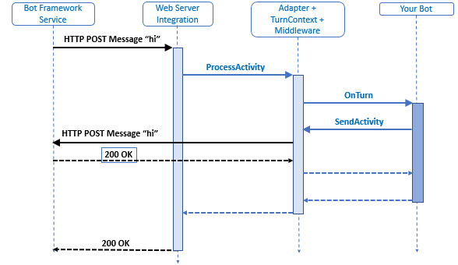
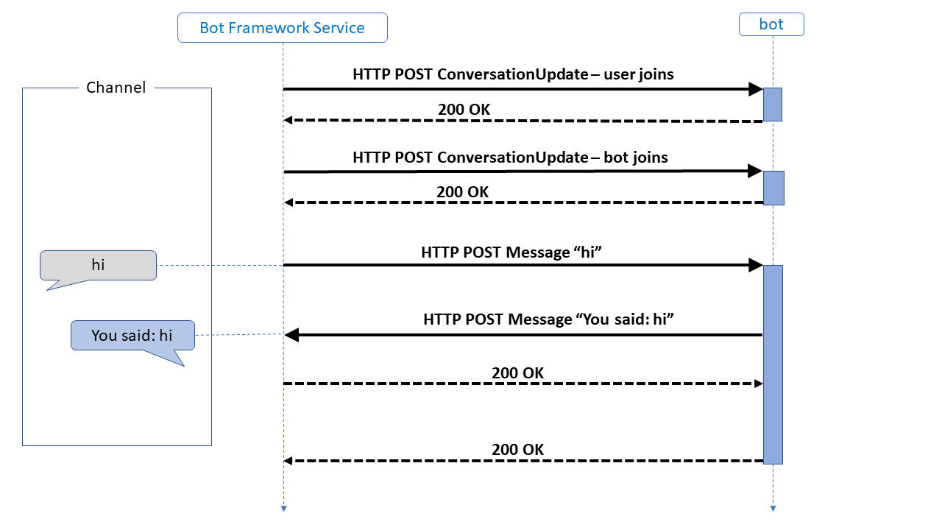
How Bots work
Information:
Bot Framework service
Web Server
Middleware
Bot
[Use this space to place an image that best captures the main idea of the speech]
Notes:
Use the background points to post details that are not common knowledge, or that the audience will need to understand the context of the speech.
-Do not read these main points from the PowerPoint, instead elaborate on these points during the speech.

Slide 3
Activity Handler
onTurn
onMessage
onConversationUpdate
onMembersAdded
onDialog
Turn is one whole conversational cycle
Notes:
Dedicate this entire slide to the thesis statement. It is the reason the speech is being given. Use this time to reveal the three main points of the speech (slides 4,5,6) as an overview for the direction of the speech:
-[type main point #1 here]
-[type main point #2 here]
-[type main point #3 here]
Be sure to transition to the first main point and the next slide.

Slide 4
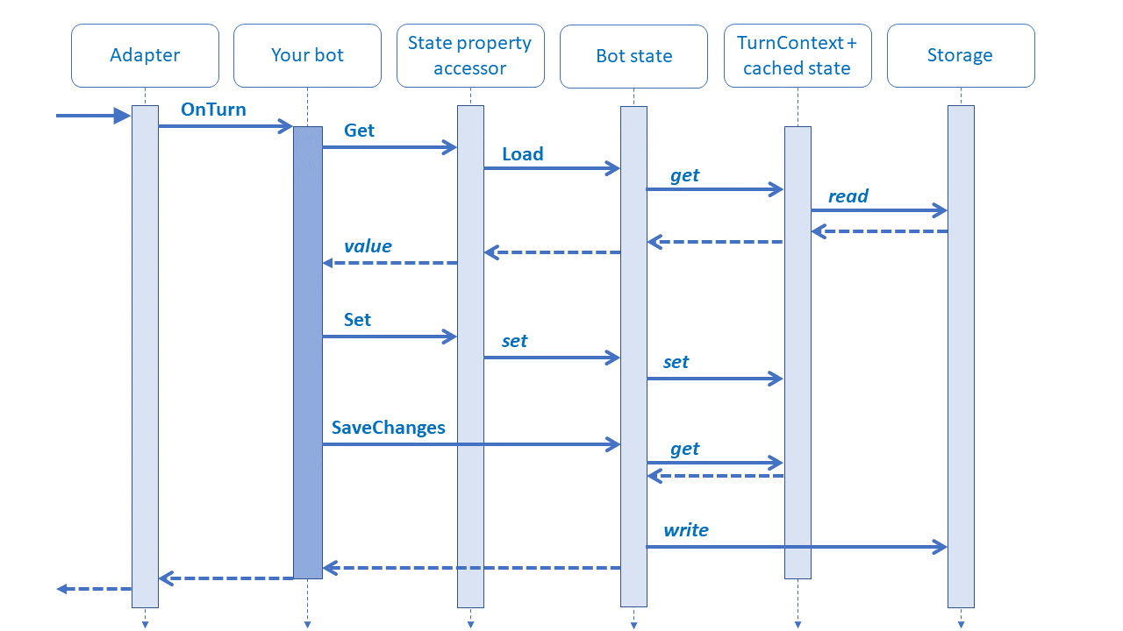
State Management
User state
Conversation state
Private conversation state
[use this space to place an image that best captures the main idea of point #1]
Notes:
The title of main point #1 should be clear and concise. Each piece of evidence should be summarized for clarity and cited correctly. Do not simply read the pieces of evidence, but elaborate where needed.
[type notes for elaboration here]
Be sure to transition to main point #2 and the next slide.

Slide 5
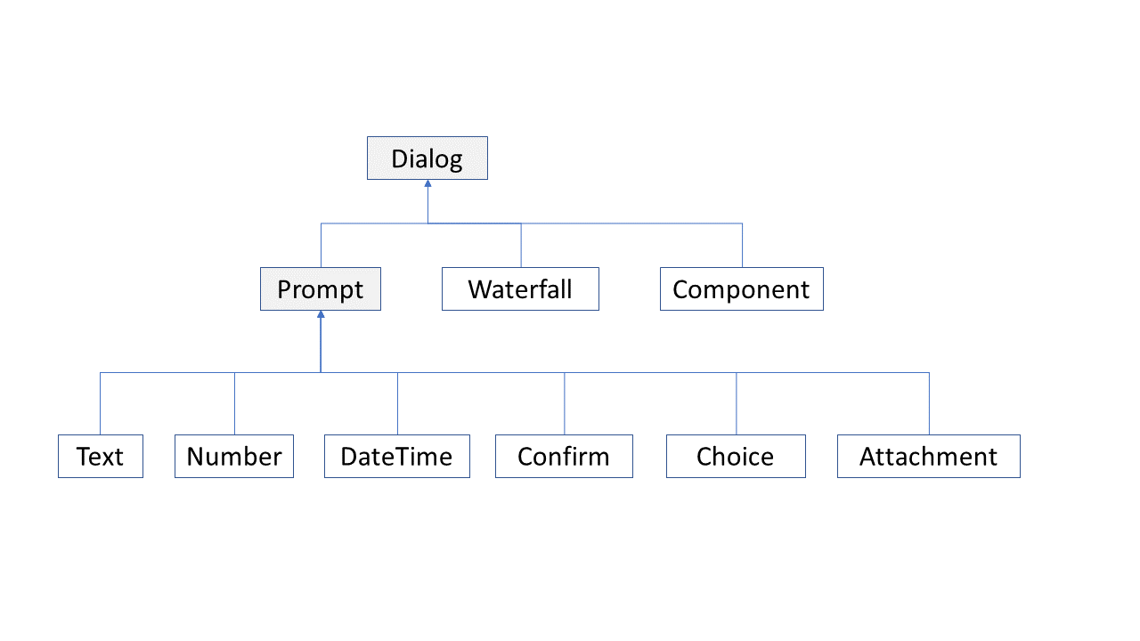
Dialogs
Notes:
The title of main point #2 should be clear and concise. Each piece of evidence should be summarized for clarity and cited correctly. Do not simply read the pieces of evidence, but elaborate where needed.
[type notes for elaboration here]
Be sure to transition to main point #3 and the next slide.

Slide 6
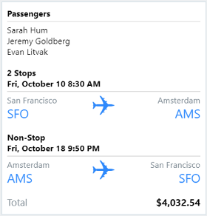
Services
Language Understanding
Q & A
Speech Services
Adaptive Cards
Notes:
The title of main point #3 should be clear and concise. Each piece of evidence should be summarized for clarity and cited correctly. Do not simply read the pieces of evidence, but elaborate where needed.
[type notes for elaboration here]
Be sure to transition to the counterargument and the next slide.

Slide 7
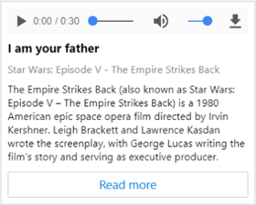
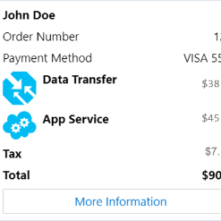
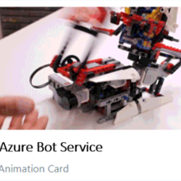
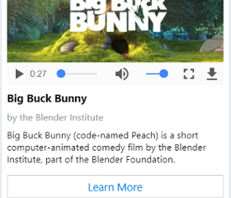
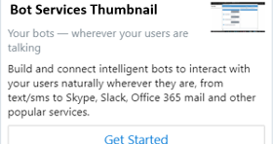
Cards
Animation
Hero
Adaptive
Audio
Thumbnail
Receipt
Video
Carousel
Notes:
The title of main point #3 should be clear and concise. Each piece of evidence should be summarized for clarity and cited correctly. Do not simply read the pieces of evidence, but elaborate where needed.
[type notes for elaboration here]
Be sure to transition to the counterargument and the next slide.

Slide 8
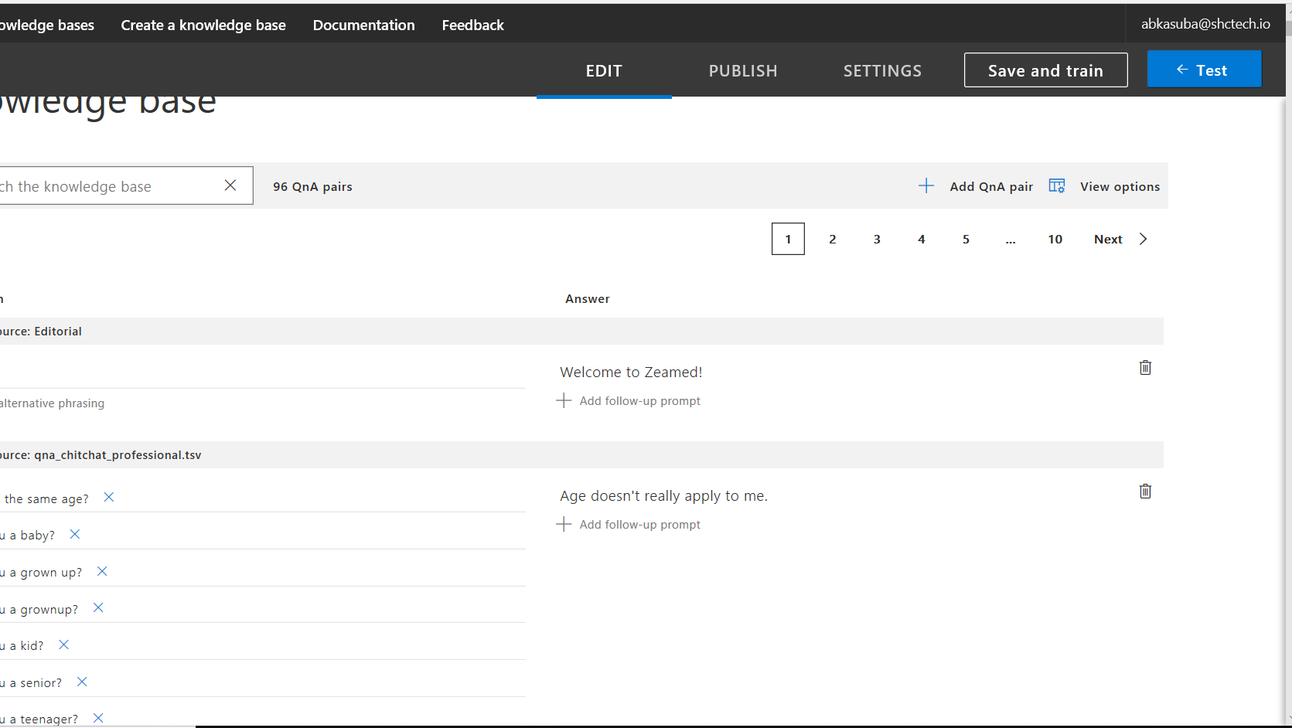
QnA Maker
[Use this space to place an image that best captures the main idea of the action step]
Notes:
The action step is what the audience is supposed to do or think about the topic. It should be one sentence that is written clearly and with much thought. It may also be the thesis statement restated as an action. The goal of this slide is to leave the audience with a clear message as to what they are to do or think at the end of the speech. It may be a good idea to end with a powerful quote or image.

Slide 9
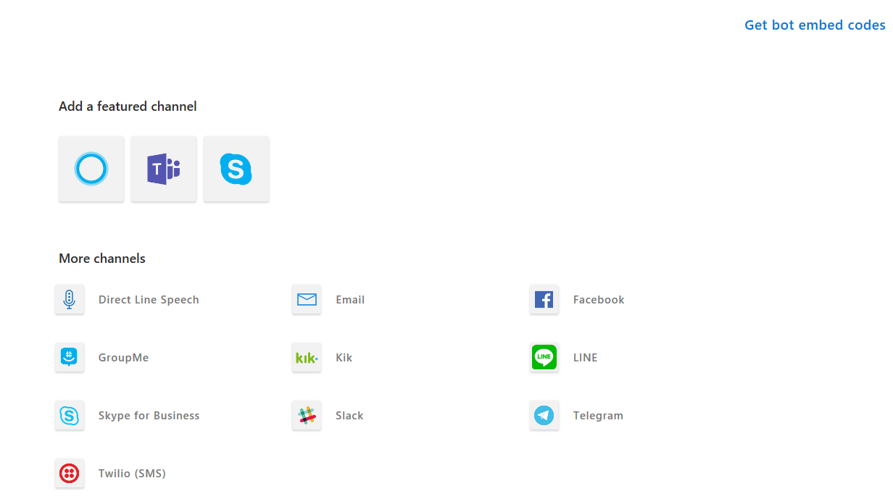
Channels
Template Editing Instructions and Feedback

